Slide 1


“Information Security”
Lecture # 11
Dr. Engr. M Malook Rind
Ph.D (I.T), ME (CSN), MBA (MIS), BE (CS)
CCNA, CCNP, Juniper Certified.
Professor (Computer Science)

Slide 2

Contents
Network Security Appliances and Technologies
Dr. M Malook Rind Information Security Lecture 11

Slide 3
Network Security Appliances and Technologies
Different Types of Network Security Appliances
Network Security Technologies
Dr. M Malook Rind Information Security Lecture 11

Slide 4
Network Security Appliances
All modern networks have both standard networking devices (such as switches and routers) and specialized security appliances
Security can be achieved through appliances that directly address security and by using the security features in standard networking devices
Using both standard networking devices and security appliances can result in a layered security approach which can significantly improve security.
Following appliances can be dedicated to protecting a network:
Firewalls
Proxy servers
Deception instruments
Intrusion Detection and Prevention Systems (IDS & IPS)
Security Technologies
Dr. M Malook Rind Information Security Lecture 11

Slide 5
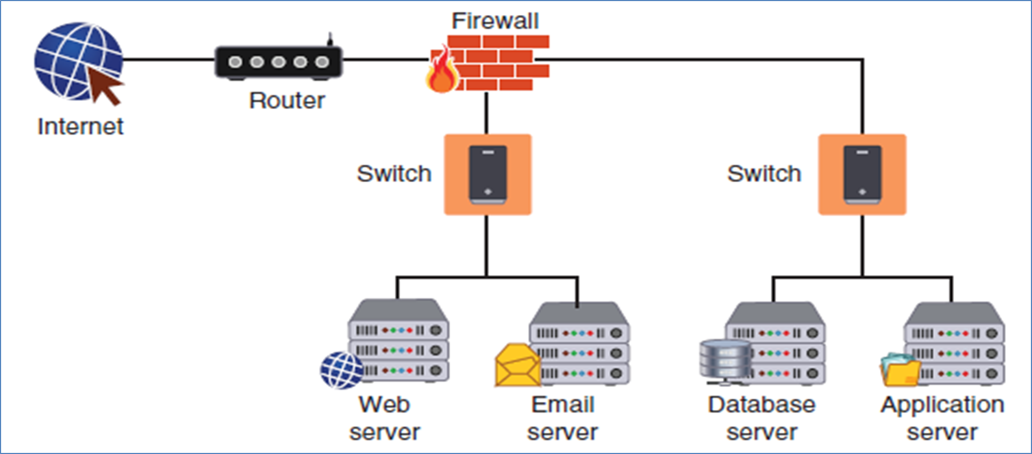
Network Security Appliances - Firewall
Firewalls are designed to limit the spread of malware.
Firewalls are an important element in network security, but they fall far short of being the ultimate defense
To use firewalls effectively, you must understand the function of firewalls and know different types of firewalls and specialized firewall appliances
Appliance firewall
Dr. M Malook Rind Information Security Lecture 11

Slide 6
Network Security Appliances - Firewall
Firewall Functions
A firewall uses bidirectional inspection to examine both outgoing and incoming network packets.
It allows approved packets to pass through but can take different actions when it detects a suspicious packet.
The actions are based on specific criteria or rules; these types of firewalls are called rule-based firewalls
Firewall rules can contain parameters such as the following:
Source address
Destination address
Source port
Destination port
Protocol
Direction
Priority
Time
Context/URL
Action
Dr. M Malook Rind Information Security Lecture 11

Slide 7
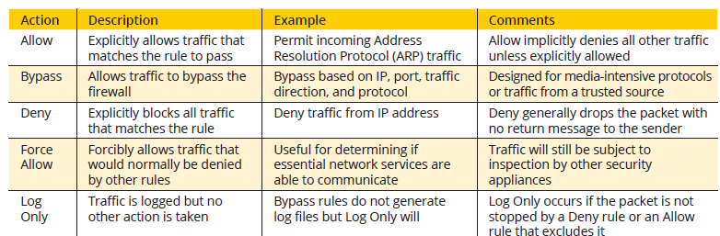
Network Security Appliances - Firewall
Typical firewall rule actions
Dr. M Malook Rind Information Security Lecture 11

Slide 8
Network Security Appliances - Firewall
Firewall Categories
Stateful vs. stateless
Stateful = Checks firewall rules and keeps a record of the state of the connection (sender and receiver)
Stateless = Only checks packets based on firewall rules.
Open source vs. proprietary (Open source = more features)
Hardware vs. software
Hardware = are specialized separate devices that inspect traffic (more expensive but more features).
Software = runs as a program or service on a device, such as a computer or router.
Host vs. appliance vs. virtual
Host = a software firewall that runs on and protects a single device (a host). (Windows Defender Firewall)
Appliance = is typically a separate hardware device designed to protect an entire network.
Virtual = runs in the cloud for public cloud environment.
Dr. M Malook Rind Information Security Lecture 11

Slide 9
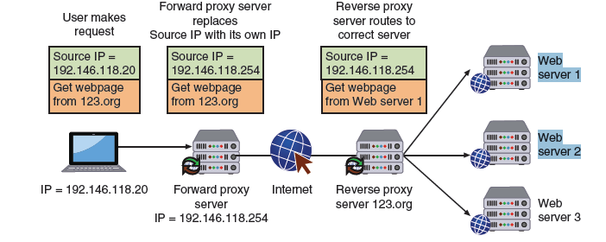
Network Security Appliances - Proxy Servers
Proxies are devices in networking that act as substitutes on behalf of the primary device
A forward proxy is a computer or an application that intercepts user requests from the internal secure network and processes the requests on behalf of the user.
A reverse proxy routes requests coming from an external network to the correct internal server
A proxy server can provide a degree of protection
It can look for malware by intercepting it before it reaches the internal endpoint.
It can hide the IP address of endpoints inside the secure network so that only the proxy server’s IP address is used on the open Internet.
Dr. M Malook Rind Information Security Lecture 11

Slide 10
Network Security Appliances - Deception Instruments
Deception can be used as a security defense
By directing threat actors away from a valuable asset to something that has little or no value
Network deception can involve creating and using honeypots and sinkholes
Honeypots
A honeypot is a computer located in an area with limited security that serves as “bait” to threat actors
Two goals of using a honeypot:
Deflect (away from real servers)
Discover (revealing attack techniques)
A honeynet is a network of honeypots set up with intentional vulnerabilities
Sinkholes
A sinkhole is a “bottomless pit” designed to steer unwanted traffic away from its intended destination to another device
The goal is to deceive the threat actor into thinking the attack was successful
Dr. M Malook Rind Information Security Lecture 11

Slide 11
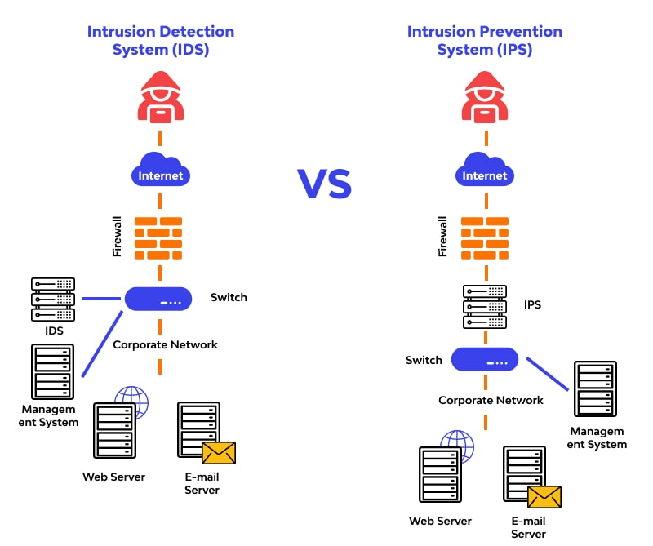
Network Security Appliances - Intrusion Detection and Prevention Systems
An Intrusion Detection System (IDS) is defined as a solution that monitors network events and analyzes them to detect security incidents and imminent threats.
An Intrusion Prevention System (IPS) is defined as a solution that performs intrusion detection and then goes one step ahead and prevents any detected threats.
These security solutions protect businesses by proactively thwarting potential cybersecurity incidents.
Dr. M Malook Rind Information Security Lecture 11

Slide 12
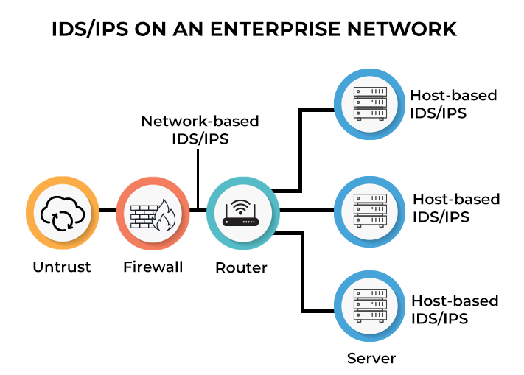
Network Security Appliances - Intrusion Detection and Prevention Systems
Dr. M Malook Rind Information Security Lecture 11

Slide 13
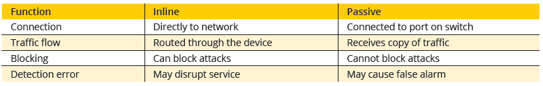
Network Security Appliances - Intrusion Detection and Prevention Systems
IDS Operation:
An IDS (Intrusion Detection System) monitors the traffic on a computer network to detect any suspicious activity.
It analyzes the data flowing through the network to look for patterns and signs of abnormal behavior.
The IDS compares the network activity to a set of predefined rules and patterns to identify any activity that might indicate an attack or intrusion.
If the IDS detects something that matches one of these rules or patterns, it sends an alert to the system administrator.
The system administrator can then investigate the alert and take action to prevent any damage or further intrusion.
IDS Deployment Options
Inline vs. passive IDS
Dr. M Malook Rind Information Security Lecture 11

Slide 14
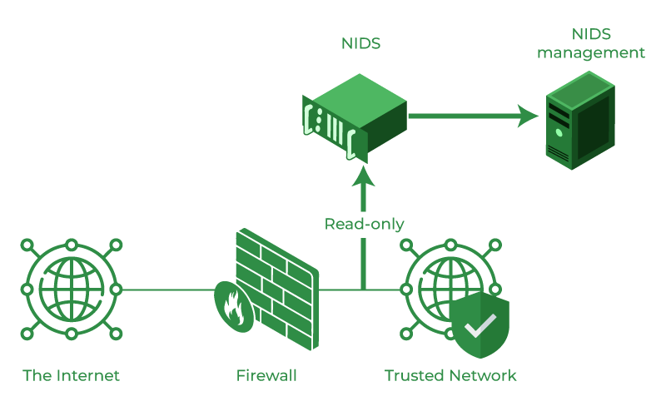
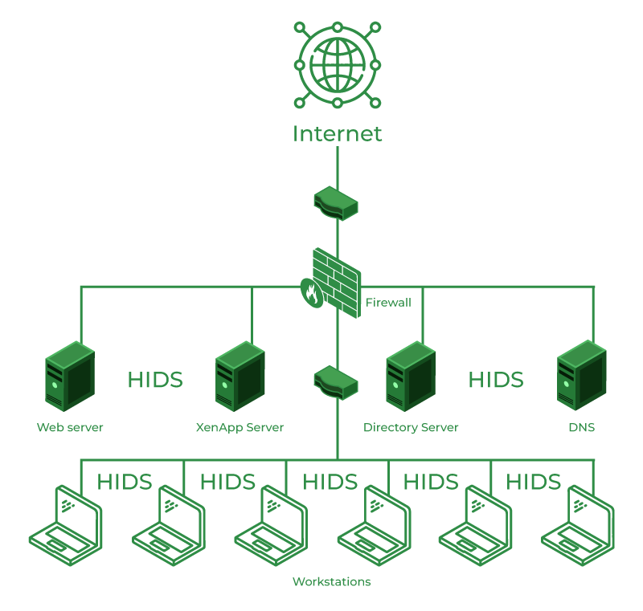
Network Security Appliances - Intrusion Detection and Prevention Systems
Classification of Intrusion Detection System:
IDS are classified into 5 types
Network Intrusion Detection System (NIDS): is deployed at a strategic point or points within the network, where it can monitor inbound and outbound traffic to and from all the devices on the network. Once an attack is identified or abnormal behavior is observed, the alert can be sent to the administrator.
Host Intrusion Detection System (HIDS): run on independent hosts or devices on the network. A HIDS monitors the incoming and outgoing packets from the device only and will alert the administrator if suspicious or malicious activity is detected.
Dr. M Malook Rind Information Security Lecture 11

Slide 15
Network Security Appliances - Intrusion Detection and Prevention Systems
Protocol-based Intrusion Detection System (PIDS):
A specific IDS that monitors the protocol in use.
This system typically analyzes the HTTP or HTTPS protocol stream between your devices and the server.
In most cases, a PIDS will go at the front end of a server.
The system can protect your web server by monitoring inbound and outbound traffic.
Application Protocol-based Intrusion Detection System (APIDS):
Specializes in software app security.
Typically associated with host-based intrusion detection systems (HIDS), APIDSs monitor the communications that occur between applications and the server.
An APIDS is typically installed on groups of servers.
Hybrid Intrusion Detection System:
is made by the combination of two or more approaches to the intrusion detection system.
In the hybrid intrusion detection system, the host agent or system data is combined with network information to develop a complete view of the network system.
The hybrid intrusion detection system is more effective in comparison to the other intrusion detection system.
Dr. M Malook Rind Information Security Lecture 11

Slide 16
Network Security Appliances - Intrusion Detection and Prevention Systems
Monitoring Methodologies used by IDS/IPS
Monitoring involves examining network traffic, activity, transactions, or behavior to detect security-related anomalies.
Anomaly-based Monitoring: Detect unknown malware attacks as new malware. Machine learning is used to create a trustful activity model and anything coming is compared with that model and it is declared suspicious if not found in the model.
Whenever activity deviates significantly from the baseline, an alarm is raised.
Signature-based Monitoring: Detects on the basis of the already known malicious instruction sequence that is used by the malware. The detected patterns in the IDS are known as signatures.
Signature-based IDS can easily detect the attacks whose pattern (signature) already exists in the system but it is quite difficult to detect new malware attacks as their pattern (signature) is not known. Signature database must be constantly updated.
Behavior-based Monitoring: Attempts to overcome the limitations of both anomaly-based monitoring and signature based monitoring by being adaptive and proactive instead of reactive.
Continuously analyzes the behavior of processes and programs on a system and alerts the user if it detects any abnormal actions
Alerts user who decides whether to allow or block activity.
Heuristic Monitoring: Uses experience-based techniques and attempts to answer the question “Will this do something harmful if it is allowed to execute?”
Dr. M Malook Rind Information Security Lecture 11

Slide 17
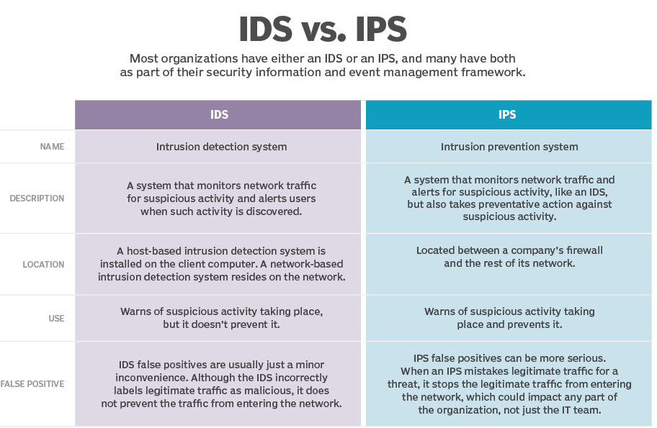
Network Security Appliances - Intrusion Detection and Prevention Systems
Dr. M Malook Rind Information Security Lecture 11

Slide 18
Network Security Appliances - Security Technologies
Access technologies
Access Control List (ACL)
ACL is made up of rules that either allow access to a computer environment or deny it.
is a list of permissions that dictate what a user has access to and what types of operations they are allowed to do with that access.
Two types of ACLS include:
File system ACLs: tells the operating system which users can access the system and which privileges they are granted.
Networking ACLs: tells the routers and switches what traffic is allowed access to the network and what type of activity is allowed.
ACLs can also be categorized by the way they identify traffic:
1. Standard ACLs: filter only the source address of the data packet.
Block or allow an entire protocol suite using source IP addresses.
2. Extended ACLs: block or allow network traffic based on a more differentiated set of characteristics that includes uses source IP, Destination IP, source port, and Destination port.
Dr. M Malook Rind Information Security Lecture 11

Slide 19
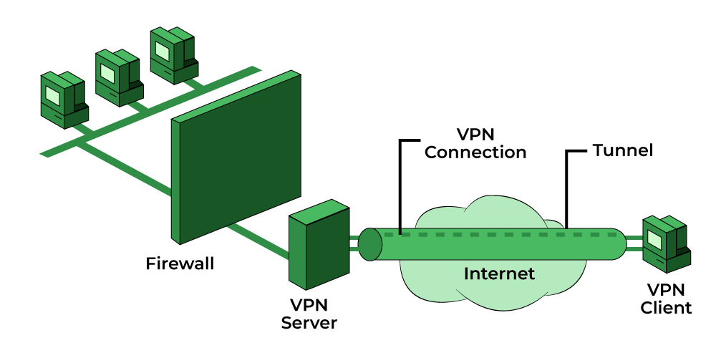
Network Security Appliances - Security Technologies
B) Virtual Private Network (VPN)
A VPN is a security technology that enables authorized users to use an unsecured public network (the Internet) as if it were a secure private network.
It provides a secure, encrypted connection between two points.
VPN creates a virtual tunnel to transfer data.
VPN Protocols:
Internet Protocol Security (IPSec)
Layer 2 Tunneling Protocol (L2TP)
Point–to–Point Tunneling Protocol (PPTP)
SSL and TLS
Secure Shell (SSH)
SSTP (Secure Socket Tunneling Protocol)
WireGuard
Dr. M Malook Rind Information Security Lecture 11

Slide 20
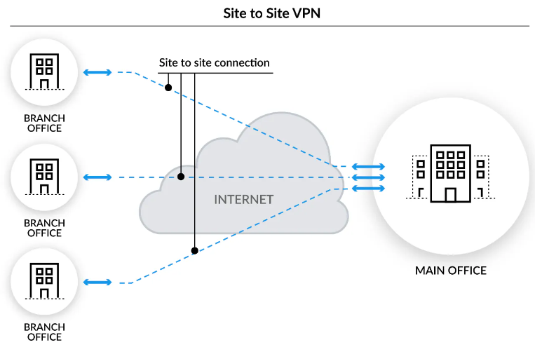
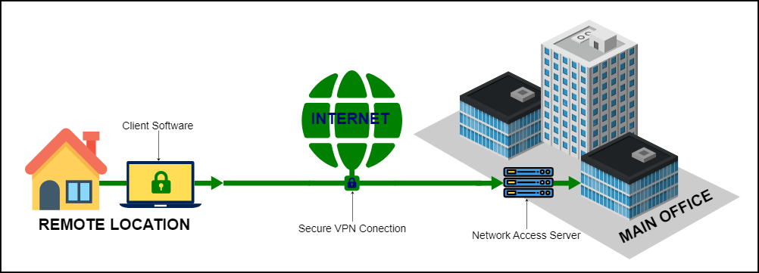
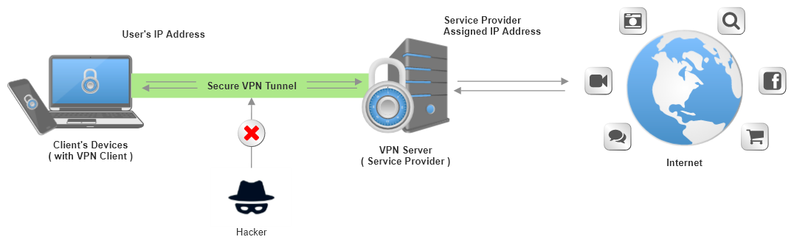
Network Security Appliances - Security Technologies
Types of VPNs
Site-to-Site VPN: designed to securely connect two geographically-distributed sites. It is a connection between two or more networks, such as a corporate network and a branch office network.
Remote Access VPN: is designed to link remote users securely to a corporate network. Iddeal for organizations that need to give employees or others out-of-office access to the company network
Personal VPN: Establishes a digital connection between your computer and a remote server owned by a VPN provider, creating a point-to-point tunnel that encrypts your personal data, masks your IP address, and lets you sidestep website blocks and firewalls on the internet.
Dr. M Malook Rind Information Security Lecture 11

Slide 21
Network Security Appliances - Security Technologies
2) Monitoring and managing technologies
Port Security
Threat actors who access a network device through an unprotected ports can be blocked.
Route security is the trust of packets sent through a router
False route information can be injected by attackers through unprotected ports.
Packet Capture and Analysis
Analyzing packets helps to monitor network performance and reveal cybersecurity incidents
Monitoring traffic on switches can be done in two ways:
A separate port TAP (test access point) can be installed
Port mirroring (also called port spanning) allows the administrator to configure the switch to copy traffic on some or all ports to a designated monitoring port on the switch
Monitoring Services
An external third-party monitoring service can be used to provide additional resources to assist an organization in its cybersecurity defenses such as managed SIEM platform.
Dr. M Malook Rind Information Security Lecture 11

Slide 22
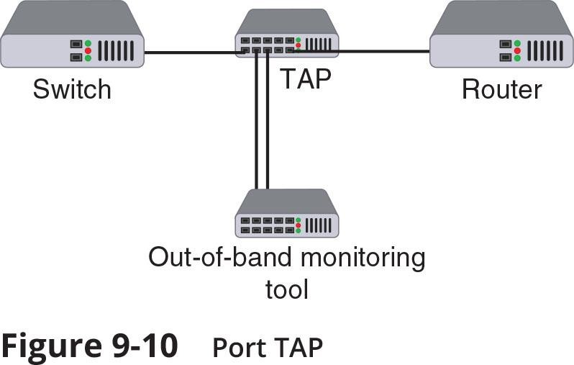
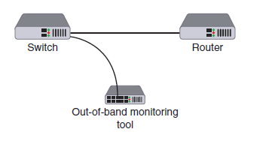
Network Security Appliances - Security Technologies
Port mirroring
Dr. M Malook Rind Information Security Lecture 11

Slide 23
Network Security Appliances - Security Technologies
3) Design Technologies
Network Segmentation
Examples of network segmentation include Virtual LANs (VLANs) and a Demilitarized Zone (DMZ).
Zero trust is a strategic initiative about networks that is designed to prevent successful attacks, it attempts to eliminate the concept of trust from an organization’s network architecture, so zero trust requires that networks be segmented.
A network can be segmented by separating devices into logical groups by creating a Virtual LAN (VLAN), allowing scattered users to be logically grouped together.
VLANs can be isolated so that sensitive data is transported only to members of the VLAN, this is helpful as grouping by user can be difficult because all users might not be in the same location and served by the same switch.
A Demilitarized Zone (DMZ) is a separate network located outside secure network perimeter
Untrusted outside users can access DMZ but cannot enter the secure network
Dr. M Malook Rind Information Security Lecture 11

Slide 24
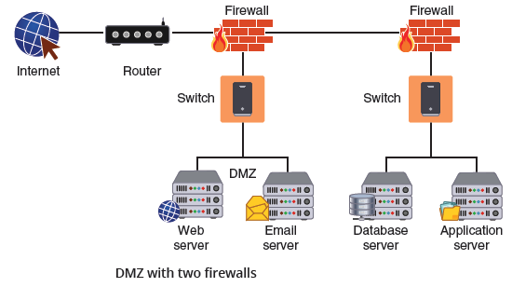
Network Security Appliances - Security Technologies
Dr. M Malook Rind Information Security Lecture 11

Slide 25
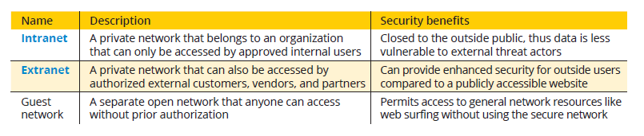
Network Security Appliances - Security Technologies
3) Design Technologies
Network Segmentation
Other network zones
Dr. M Malook Rind Information Security Lecture 11

Slide 26
Network Security Appliances - Security Technologies
3) Design Technologies
B) Load Balancing
An Load balancing is a technology that can help to evenly distribute work across a network and can allocate requests among multiple devices
Advantages of load-balancing technology:
A Reduces probability of overloading a single server
Optimizes bandwidth of network computers
Security advantages of using a load balancer:
They can detect and stop attacks directed at a server or application
Can also detect and prevent protocol attacks
Dr. M Malook Rind Information Security Lecture 11

Slide 27
Thanks
Dr. M Malook Rind Information Security Lecture 11

